Slide 1
Retrieval-Augmented Generation (RAG) LLM
AI Boot Camp FInal Project
Team Members: Jeff Flachman Kerek Spinney Ashwini Kumar
Notes:
Ash

Slide 2
Purpose:
Local Large Language Model (LLM) capable of reviewing, summarizing, and leveraging proprietary documents to facilitate a local knowledge base.
Key Features:
Utilize RAG (Retrieval-Augmented Generation) Workflow to create and query the datastore of documents
Loads documents (e.g. pdf, word, etc) into a vector database
Use LLM answer query based on the content from the data files
Provides a summary of the content based on a query
Quick knowledge base retrieval
Can be deployed on a laptop or url
Scaleable
Exec Summary
Notes:
When discussing our project we had see in our day jobs where companies face challenges with implementing a chat bot and how do they reduce hallucinations and use LLM’s to query the company documents.

Slide 3

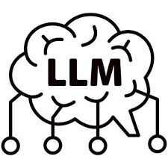
Build Prototype version using RAG and LLM
Load data related to “GenAI”
Give the user the ability to ask a knowledge base questions and return with accurate answers
Goals
Notes:
Ash

Slide 4

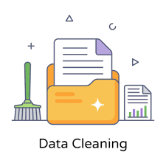
Researched and Gathered information related to GenAI.
Saved all content as PDF and loaded into Data folder
PDFs are a graphic method for printing a document.
They do not contain attributes like header, footer, footnotes, etc.
These artifacts end up in the middle of paragraph the spans two pages.
This greatly impacts the effectiveness of a RAG solution.
Text files and Word Documents are better formats to import with fewer document artifacts impacting the effectiveness of the solution
Data Collection & Cleaning

Slide 5
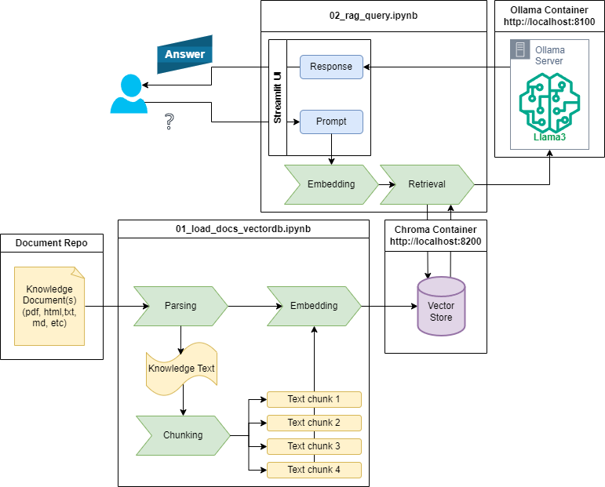
Technical Approach
Notes:
Shawn

Slide 6
Importing documents:
Chunk/Splitting the text can be done in many different ways.
Word Tokens: Or random groups of works is too Simple
Implemented: Split into sentences as chunks
Future Goal: Semantic splitting groups sentences that talk about the same type of information using embeddings of each sentence group
LLM Selection:
Trade off between model size and model robustness
Used Huggingface Leaderboard: to select the best performing model for a model size.
Running on a local laptop limits the size of the models that can be used.
More performance models are ~0.5 Billion parameters model vs 7b or 70b.
Selected 0.5b model to provide perfant response on local system.
RAG Prompts
Many options for RAG Prompts
Model Optimization

Slide 7
Demo
DEMO
Notes:
Jeff

Slide 8


Setting up Docker.
Finding materials online to assist in our project.
Sort through many different approaches that did not necessarily meet our deployment methods.
Combining all portions of the project and have it run.
Taking on a large project.
Using PDFs.
Challenges
Encountered
Notes:
Kerek - had to work on Docker

Slide 9



Test other LLM model options.
Test other chunking/splitting functions.
Test additional data and file types
Work with Streamlit to add a user interface.
Secure access
Future Considerations
Notes:
Kerek

Slide 10
Questions?
Notes:
Kerek

Slide 11
Python file to read, convert, chunk and load documents into the Vector Database
Vector Database: used ChromaDB in a docker container to provide easy configuration, deployment and use of the vector database
User Interface python file
Uses Streamlet to allow users to prompt questions that are answered based on the documents loaded into the vector databse
Uses the RAG workflow
Take a prompt, and get closest matching document chunks from ChromaDB
Submit the Chunks as contact along with a system context and the users prompt to the LLM
Displays the Response based on the document chunks back to the user.
LLM Server using llama-cpp-server in a docker container that loads any number of LLM models for use in the solution.
Technical Approach

